Slide 1

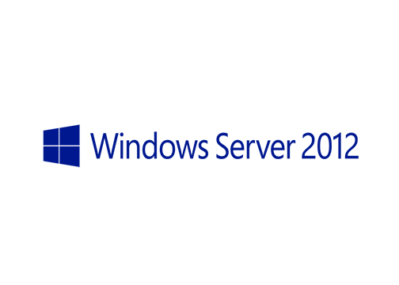
MegaSeries
Configure Hyper-V Replica Broker with Powershell

Slide 2
Info
If a VM is replicated to or from a cluster then that cluster will need a special role called the Replica Broker
This role will have the task to manage the replicated virtual machines and also to schedule on what node a replica will be placed
The primary server will replicate the VM to the name of the Broker role and then the broker will tell the primary server on what node to place the replica
In the allowed servers list use the Broker name in case you replicate from one cluster to another

Slide 3
https://www.youtube.com/channel/UCcZ-jLbPwNr8E_v9-65n8Iw https://github.com/itknowledge4

